Slide 1


Data with Linguistic Knowledge for NMT
Part of the EAMT 2024 Tutorial
Linguistically Motivated Neural Machine Translation
Haiyue Song
https://shyyhs.github.io

Slide 2






Roadmap
Linguistic knowledge in
① Model
watch/ing
ab/normal/ly
② Data
e.g.
watch/ing
ab/normal/ly
current
③ Decoding
Checklist
Ambiguity
Composition
Punctuation
Verb tense
…
④ Evaluation

Slide 3
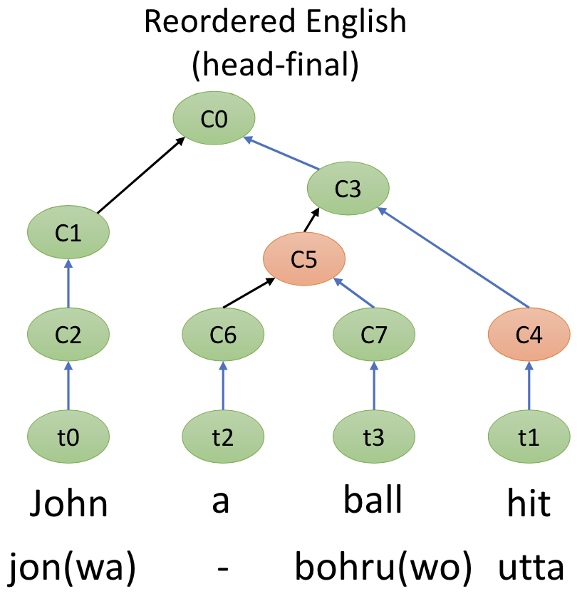


Inject Linguistic Knowledge into Data
Data Tokenization
Data from Related Languages
Word Segmentation
[1]
Script Mapping
[5] [6]
Japanese
私/も/あさって/日曜/最終/日
Chinese
她到塔皓湖去了
I / also / day after tomorrow / Sunday / last / day
……
Subword Segmentation
[2][3]
Romanization
ta dao ta hao hu qu le
watch/ing
ab/normal/ly
She went to Lake Tahoe.
watch/ing
ab/normal/ly
sea/side
save/r/s
Grammar Mapping [7]
Character Decomposition
[4]
驰
马
/也
Reorder
English (SVO) to
Japanese-like (SOV)
Chinese
run
horse

Slide 4
Word Segmentation: Motivation
Add word boundary ⇨ less ambiguity
外国 / 人 / 参政 / 権
Japanese*
外国人参政権
foreign / people / suffrage / right
right of foreigners
to vote
外国 / 人参 / 政権
foreign / carrot / regime
Add word boundary ⇨ better alignment
Chinese**
目前出现与微信、支付宝结合的趋势
word seg.
目前 / 出现 / 与 / 微信 / 、 / 支付宝 / 结合 / 的 / 趋势
English
There is a trend of integration with WeChat and Alipay
* Juman++: A Morphological Analysis Toolkit for Scriptio Continua
** PKUSEG: A Toolkit for Multi-Domain Chinese Word Segmentation
Notes:
pkuseg: https://arxiv.org/pdf/1906.11455
Jumanpp Mecab etc

Slide 5
Word Segmentation: Example
Segmentation results comparison:
Juman++*
SentencePiece**
外国人参政権
外国 / 人 / 参政 / 権
東京都知事
東京 / 都 / 知事
right of foreigners
to vote
foreign / people / suffrage / right
Tokyo governor
Tokyo / prefecture / governor
外国人参政権
外国 / 人 / 参 / 政権
東京都知事
東 / 京都 / 知事
foreign / people/ attend / regime
east / Kyoto/ governor
* Juman++: A Morphological Analysis Toolkit for Scriptio Continua
** SentencePiece: A simple and language independent subword tokenizer and detokenizer for Neural Text Processing

Slide 6

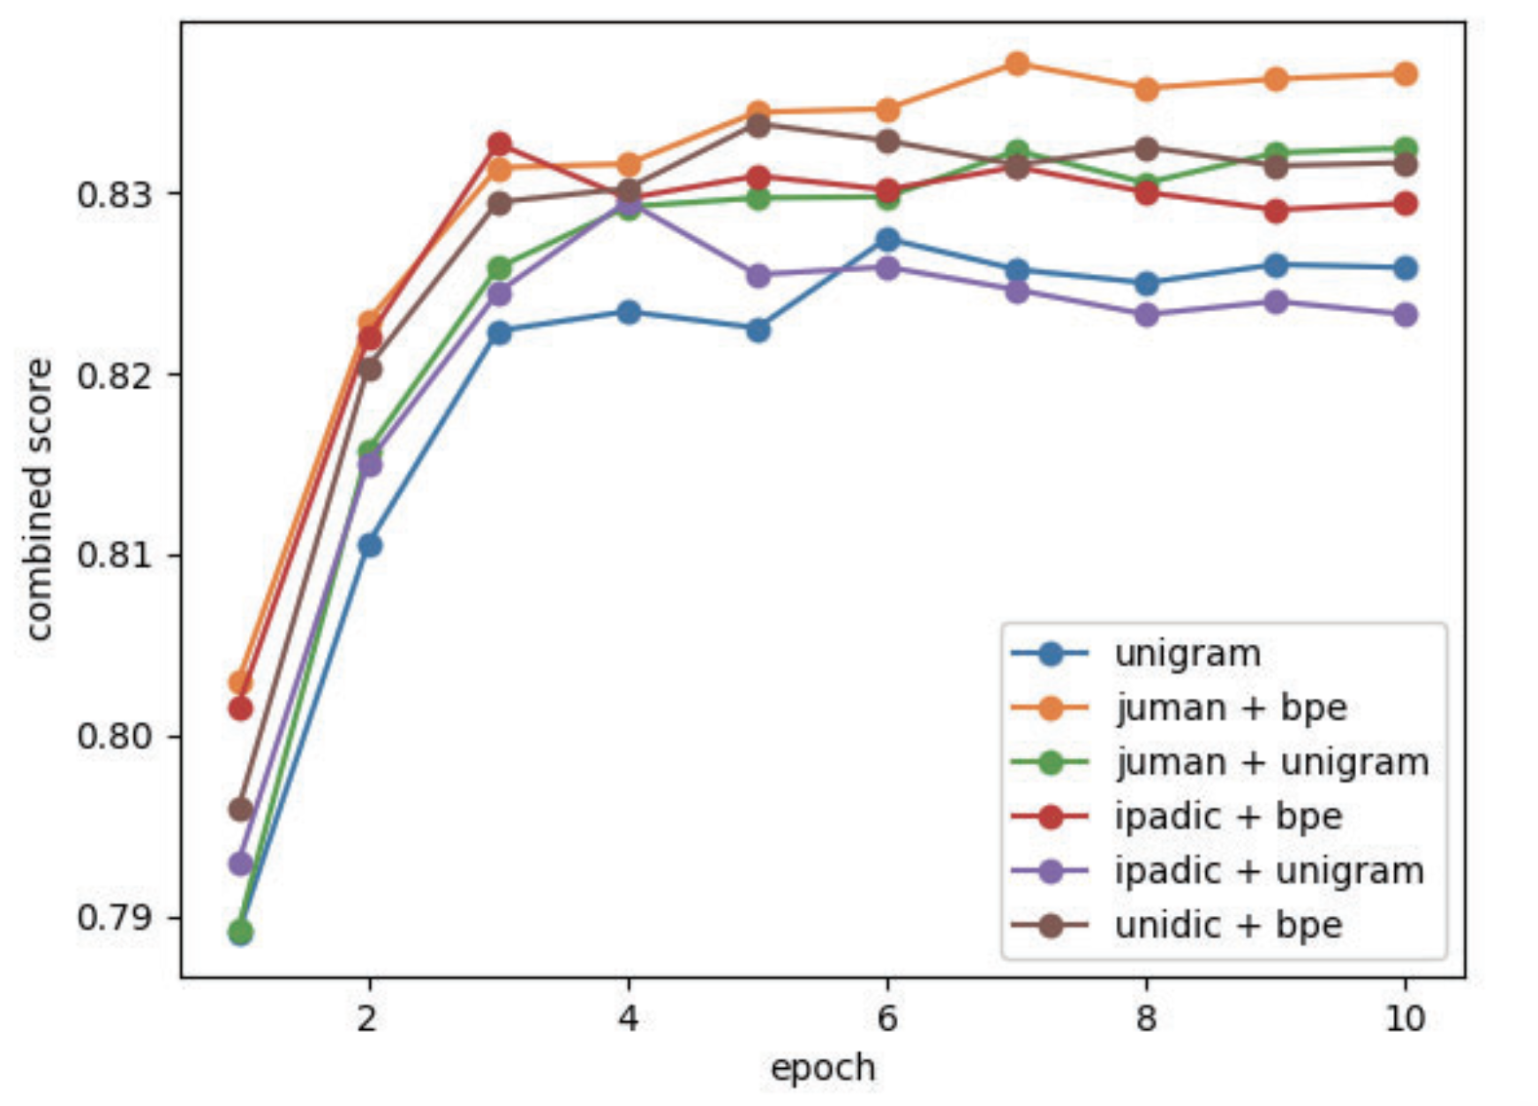
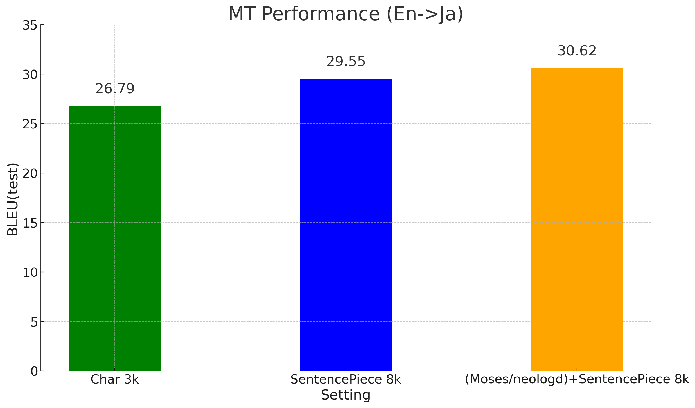
Word Segmentation: Improvements
Downsteam task performance
Juman + bpe/unigram > unigram
For Chinese and Japanese, apply word segmenter before applying tokenization.
Semantic Textual Similarity Performance
left: https://www.jstage.jst.go.jp/article/pjsai/JSAI2023/0/JSAI2023_2D6GS304/_pdf/-char/ja
right: https://github.com/google/sentencepiece/blob/master/doc/experiments.md

Slide 7
Conventional Subword Segmentation
NMT systems use subwords as the minimal unit.
Compared to word, subwords handles unseen words by segmenting them into seen subwords in the subword vocabulary.
Sentence:
There are some trademarks.
Word segmentation:
There are some <UNK>.
Subword segmentation:
There are some trade_mark_s.
*<UNK> denotes unknown words, which are not seen in the training corpora

Slide 8
Linguistically Motivated Subword Segmentation
Challenge: there are multiple segmentations for one word, which is the optimal one?
Frequency-based
(Sennrich+ 16)
Linguistically Motivated
(Song+ 22, Song+ 23)
Words
watching
languages
unknown
seaside
abnormally
savers
wat + ching
langu + ages
un + k + n + own
se + as + ide
ab + n + orm+ ally
sa + vers
watch + ing
language + s
un + know + n
sea + side
ab + normal + ly
save + r + s
Segmentation

Slide 9
Subword Segmentation: Method (1/2)
Dynamic Programming Encoding (DPE)^{[2]} is a neural segmenter trained on parallel sentences.
It maximizes the marginal likelihood of the target sentence.
…
…
Parallel sentences
彼はテレビを見ています。
…
…
[2] Dynamic Programming Encoding for Subword Segmentation in Neural Machine Translation

Slide 10
Subword Segmentation: Method (2/2)
BERTSeg
Uses semantic information from BERT embeddings.
It maximizes the marginal likelihood of the target word.
[3] BERTSeg: BERT Based Unsupervised Subword Segmentation for Neural Machine Translation

Slide 11
Subword Segmentation: Training and Decoding
Training
Maximize the generation probability of word by maximizing all possible segmentations, conditioned on its semantic embedding.
Decoding
Retrace the optimal segmentation with the maximum generation probability.
Stochastic version: sample segmentations based on their probabilities.
Notes:
The training and decoding process are the same with SelfSeg.

Slide 12
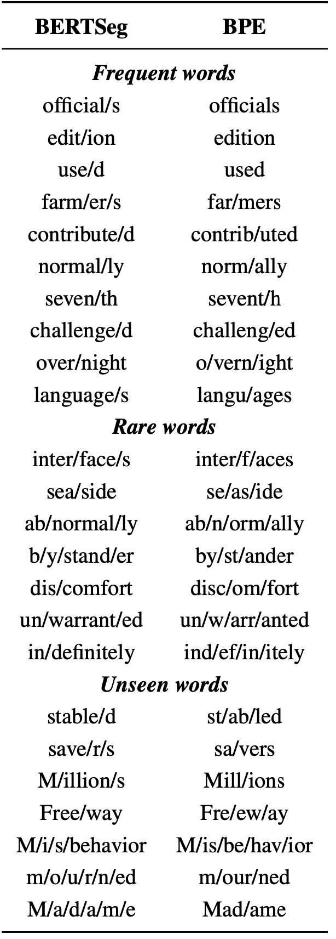
Subword Segmentation: Examples (1/2)
BERTSeg vs. BPE

Slide 13
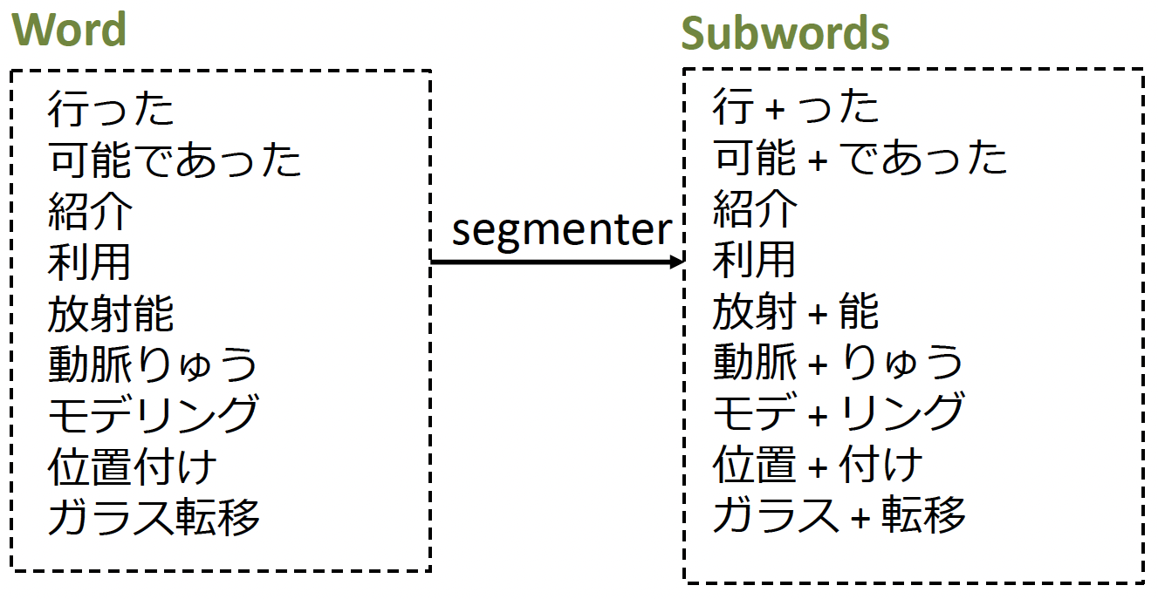
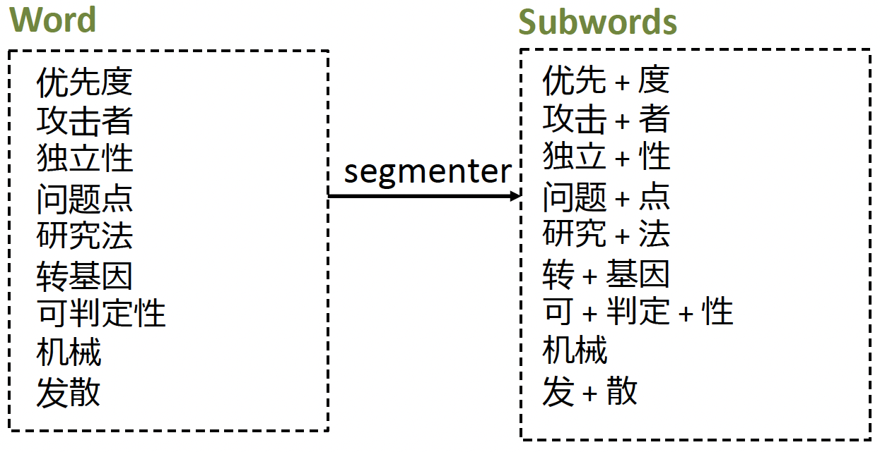
Subword Segmentation: Examples (2/2)
A multilingual segmenter using mBERT
Japanese
Chinese
*pre-tokenized by Juman++
say
13

Slide 14
Character Decomposition: Motivation
Characters in languages such as Chinese, Japanese, Korean may contain sub-characters.
Character Decomposition
森
木 / 木 / 木
驰
马
/也
forest
tree
tree
tree
run
horse
🌲
🌲
🌲
🌲
🌲
🌲
林
木 / 木
明
日
/月
woods
tree
tree
bright
sun
moon
🌲
🌲
🌲
🌲
🌞
🌛
website for character decomposition: https://www.cns11643.gov.tw/searchQ.jsp?ID=0

Slide 15
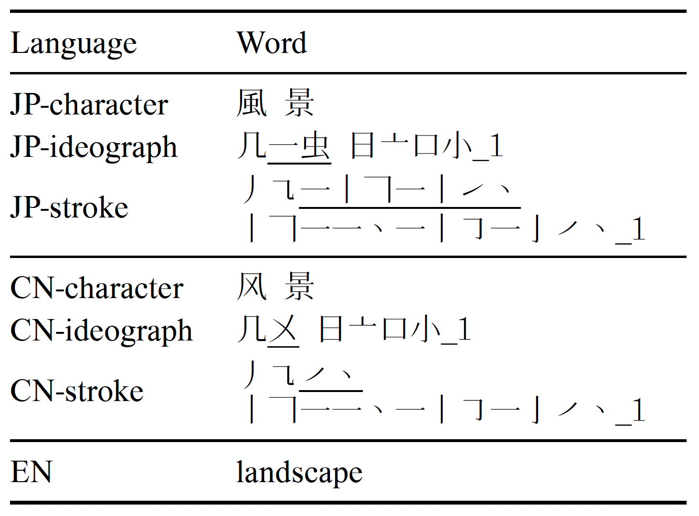
Character Decomposition: Method
Replacing characters with ideograph sequences in the training data.
Method in this paper*
Method in this paper
*Neural Machine Translation of Logographic Languages Using Sub-character Level Information

Slide 16
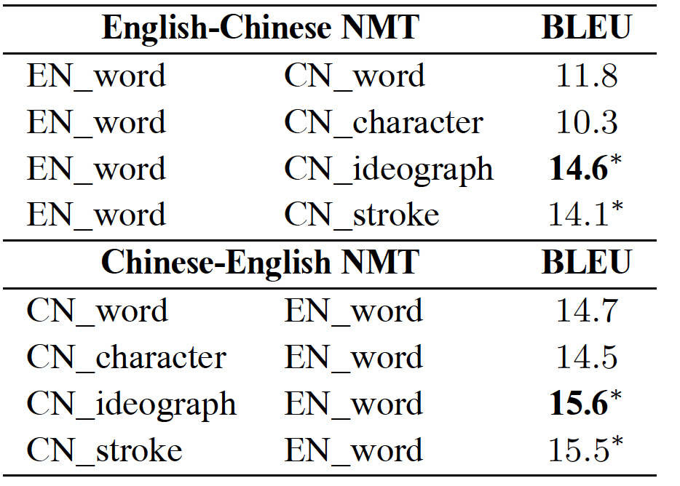
Character Decomposition: Results
Best performance compared to word/character/stroke

Slide 17
Using Data in Related Languages
Motivation
Transfer knowledge in high-resource language to low-resource language
Especially helpful if they are related (share the same grammar etc.)
Challenge
How to leverage data in different scripts?
How to leverage data in different grammars?

Slide 18
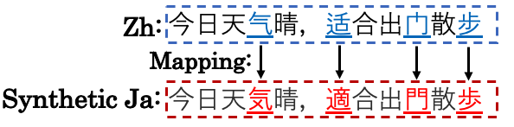
Script Mapping of Characters
From one language to another related language
By script mapping, where there is a character-to-character dictionary
Script Mapping
*
*Pre-training via Leveraging Assisting Languages for Neural Machine Translation

Slide 19

Script Mapping by Romanization
From non-Latin to Latin*
Lower-resource
High-resource
Japanese
Romanization
English
ビッグベン
Biggu Ben
Big Ben
embedding
embedding
Poorly Learned
Well Learned
*On Romanization for Model Transfer Between Scripts in Neural Machine Translation

Slide 20
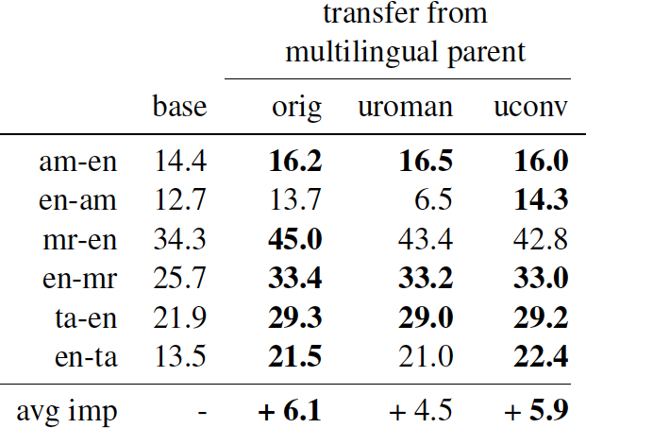
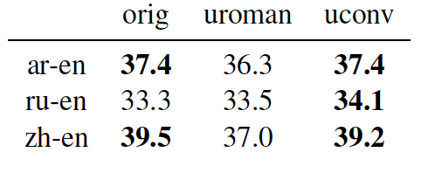
MT Performance using Romanization
Improves the performance of low-resource language ↑
But hurts the performance of high-resource language ↓

Slide 21
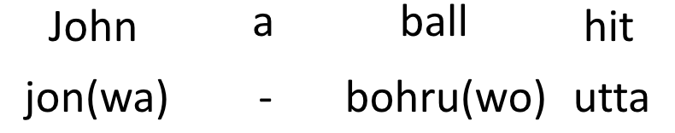
Grammar Mapping
English and Japanese have different word order
English: Subject–Verb–Object John hit a ball
Japanese: Subject–Object–Verb
Motivation
map English sentence to “English sentence with Japanese SOV word order
learn English with SOV order->English to simulate Japanese->English
Linguistically-driven Multi-task Pre-training for Low-resource Neural Machine Translation

Slide 22
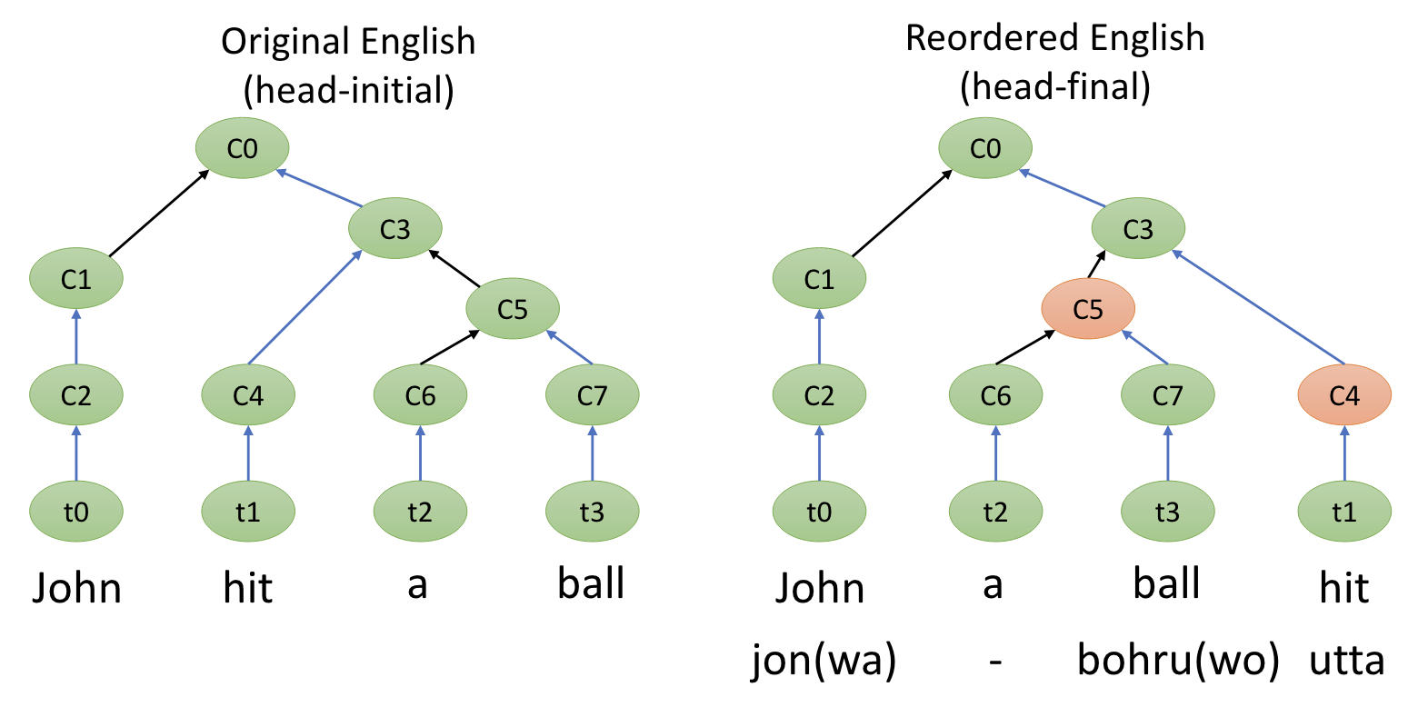
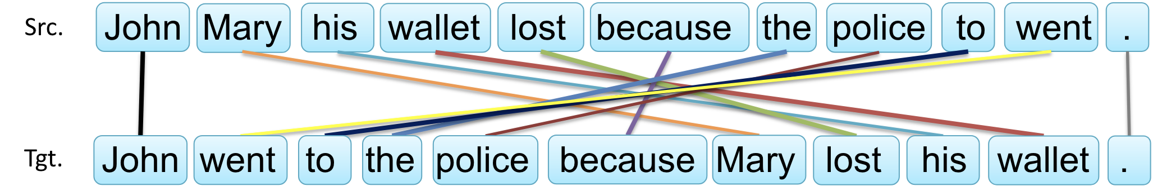
Grammar Mapping
Generate the reordered English data from head-initial to head-final
Use it in pre-training improves the Japanese->English performance
Linguistically-driven Multi-task Pre-training for Low-resource Neural Machine Translation

Slide 23
Summary
Linguistic knowledge can be injected into the (training) data
Word segmentation for languages such a Japanese and Chinese
Linguistically motivated subword segmentation
Character decomposition
Data from related languages helps through
Script mapping
Romanization
Grammar mapping

Slide 24
Open Questions
Character-level/Byte level tokenization
Character-level contains all information in theory
But it underperforms subword based methods
Because the current architecture is designed for subwords?
Knowledge transfer only in similar script
e.g., if some knowledge appears in English, if the model outputs Japanese it is hard to leverage that knowledge during generation
Romanization hurts the performance of the original language
How to transfer between languages with different scripts efficiently?

Slide 25
References
[1] Juman++: A Morphological Analysis Toolkit for Scriptio Continua
[2] Dynamic Programming Encoding for Subword Segmentation in Neural Machine Translation
[3] BERTSeg: BERT Based Unsupervised Subword Segmentation for Neural Machine Translation
[4] Neural Machine Translation of Logographic Languages Using Sub-character Level Information
[5] Pre-training via Leveraging Assisting Languages for Neural Machine Translation
[6] On Romanization for Model Transfer Between Scripts in Neural Machine Translation
[7] Linguistically-driven Multi-task Pre-training for Low-resource Neural Machine Translation

Slide 26
Linguistically Aware Decoding
Part of the EAMT 2024 Tutorial
Linguistically Motivated Neural Machine Translation
Haiyue Song
https://shyyhs.github.io

Slide 27
Decoding
String-to-Tree Decoding
Structural Template Prediction
Notes:
A figure showing this

Slide 28
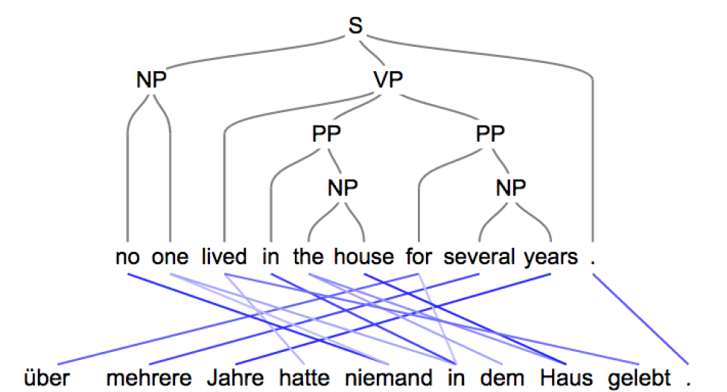
String to Syntactic Tree: Overview
Incorporate syntactic tree information [1]
Target
Syntactic Tree
🌲
Attention
Source
String
[1] Towards String-to-Tree Neural Machine Translation
Notes:
A figure showing this

Slide 29
String to Syntactic Tree: Method
Syntactic tree is linearized for the NMT model to process
Syntactic info is obtained from a specific English parser
English
Jane had a cat .
Linearized📏
Notes:
A figure showing this

Slide 30
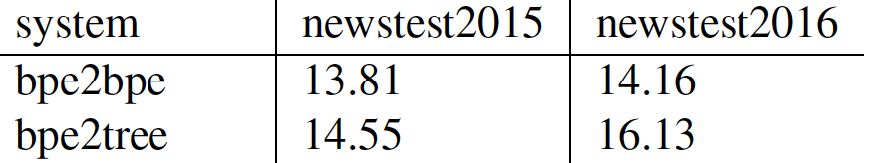
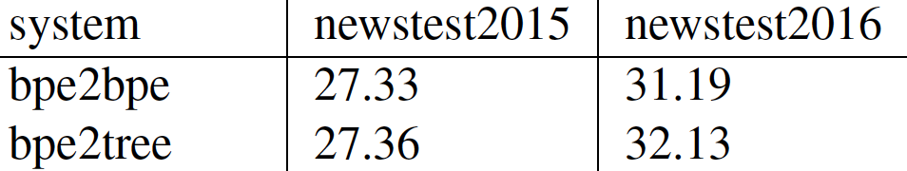
String to Syntactic Tree: Results
Helpful in low-resource scenarios
No large improvement in high-resource scenarios
166k parallel sentences low-resource scenario
German➡️English
↑
↑↑
4.5M parallel sentences
German➡️English
〜
↑
Notes:
A figure showing this

Slide 31
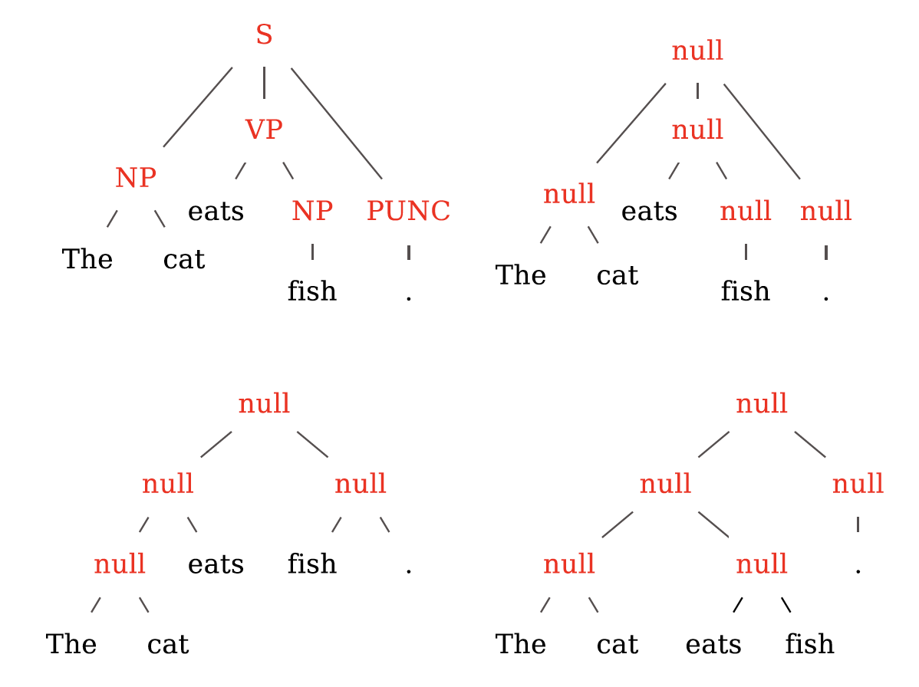
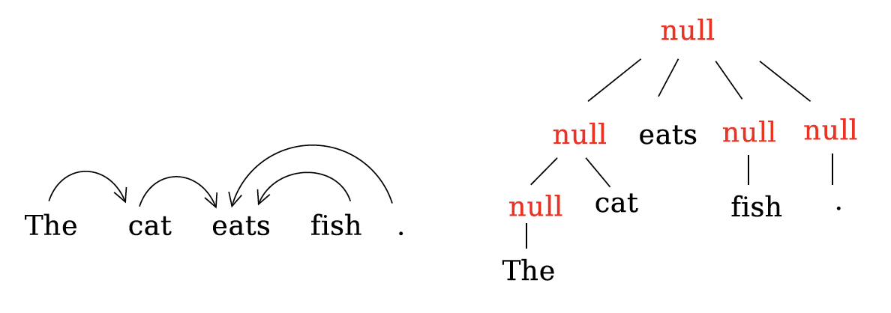
String to Any Tree: Overview
Incorporate any tree structure information [2]
Example of one parser
Different parsers
, or even not from parser
Balanced Binary Tree
[2] A Tree-based Decoder for Neural Machine Translation
Notes:
A figure showing this

Slide 32
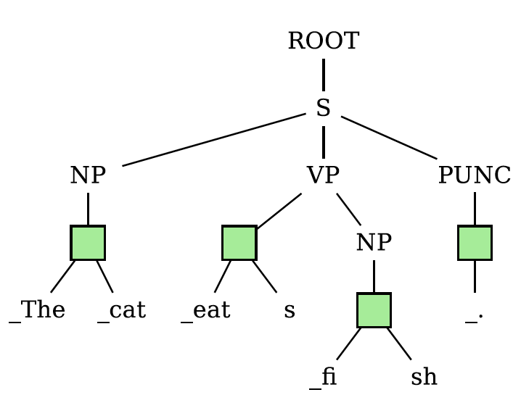
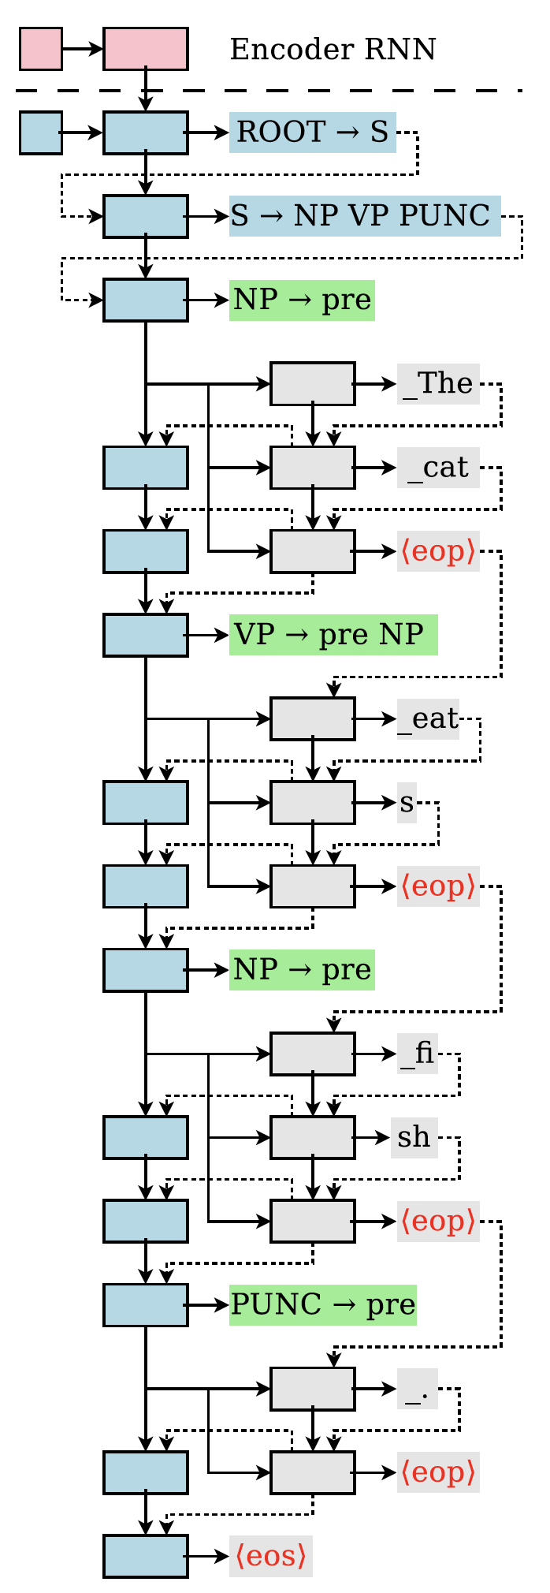
String to Any Tree: Method
Structure Cell
Tree-structure-aware decoder [2]
Word Cell
Output
Decoding
process
[2] A Tree-based Decoder for Neural Machine Translation
Notes:
A figure showing this

Slide 33
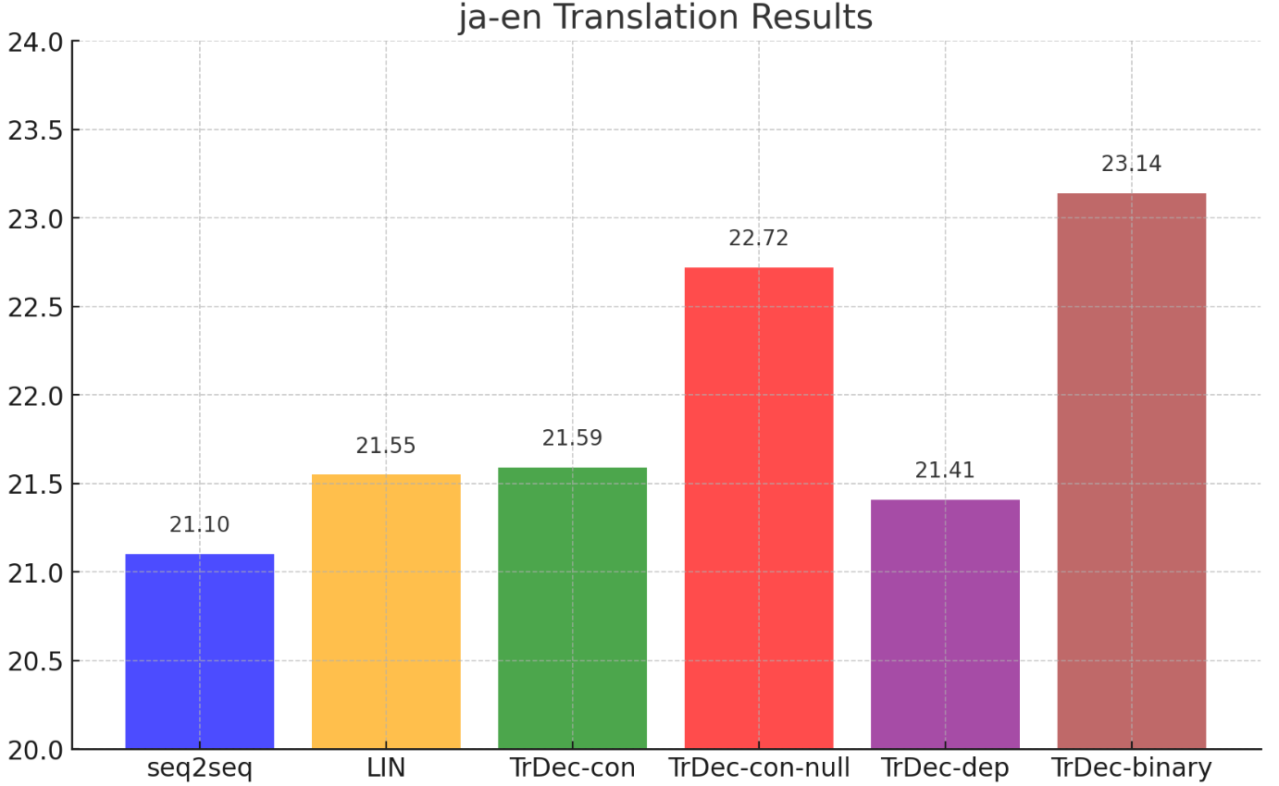
String to Any Tree: Results
Surprisingly, balanced tree also works well [2]
BLEU
constituency
dependency
w/o linguistic info
[2] A Tree-based Decoder for Neural Machine Translation
Notes:
A figure showing this

Slide 34
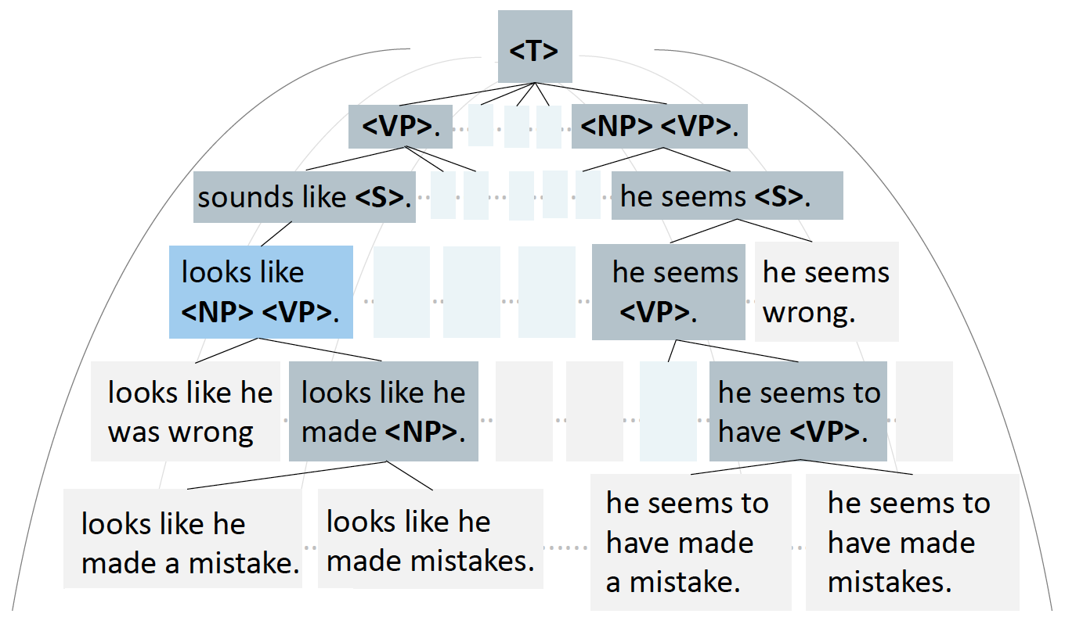
Syntax-guided Generation: Overview
Guide the decoding process using syntax information [3]
extending node
leaf node
with revision
[3] Explicit Syntactic Guidance for Neural Text Generation
Notes:
A figure showing this

Slide 35
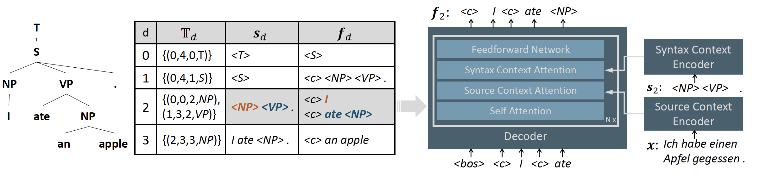
Syntax-guided Generation: Method
Training data
Decoder
Notes:
A figure showing this

Slide 36
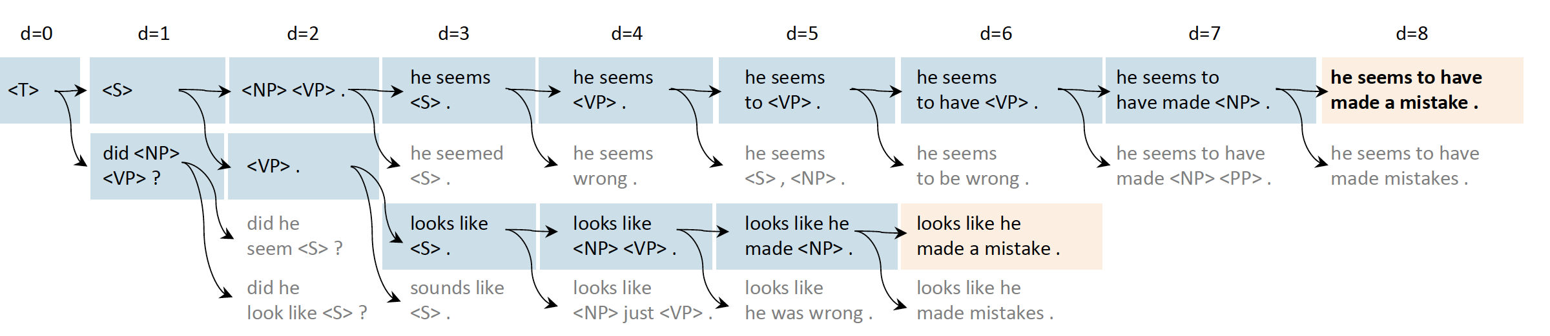
Case Study
Decoding process example [3]
[3] Explicit Syntactic Guidance for Neural Text Generation
Notes:
A figure showing this

Slide 37
Summary
Leveraging the tree-structure information in the decoder/decoding is helps, especially in low-resource scenarios.
The decoding process is also more controllable/explainable.
Notes:
A figure showing this

Slide 38
References
[1] Towards String-to-Tree Neural Machine Translation
[2] A Tree-based Decoder for Neural Machine Translation
[3] Explicit Syntactic Guidance for Neural Text Generation

Slide 39
Linguistically Motivated Evaluation for
Neural Machine Translation
Part of the EAMT 2024 Tutorial
Linguistically Motivated Neural Machine Translation
Haiyue Song
https://shyyhs.github.io

Slide 40
Evaluation
Linguistic Evaluation Benchmark
Construction
Evaluation on MT output of GPT-4
Evaluation on MT Metrics
Context-aware MT evaluation
Checklist
Ambiguity
Composition
Punctuation
Verb tense
…
Notes:
A figure showing this

Slide 41
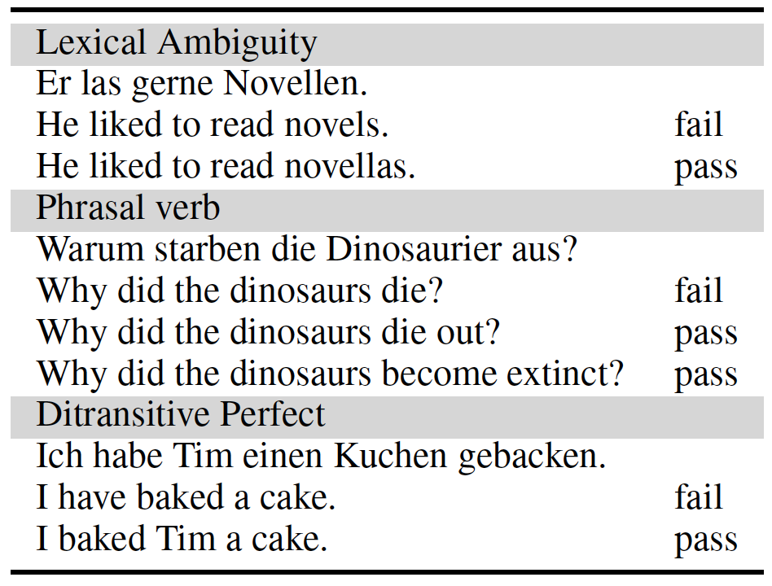
Linguistic Evaluation Benchmark
Evaluate on language-specific linguistic phenomenon [1]
German→English
[1] Linguistically motivated Evaluation of the 2022 State-of-the-art Machine Translation Systems for three Language Directions
Notes:
A figure showing this

Slide 42
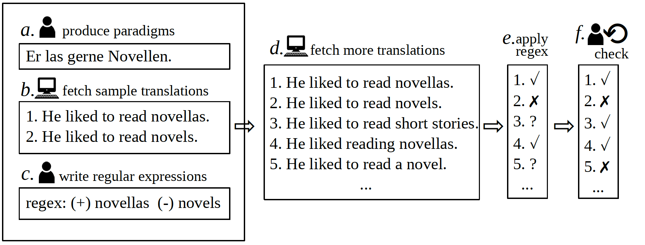
Linguistic Evaluation Benchmark: Construction
A semi-automatic pipeline
Notes:
A figure showing this

Slide 43
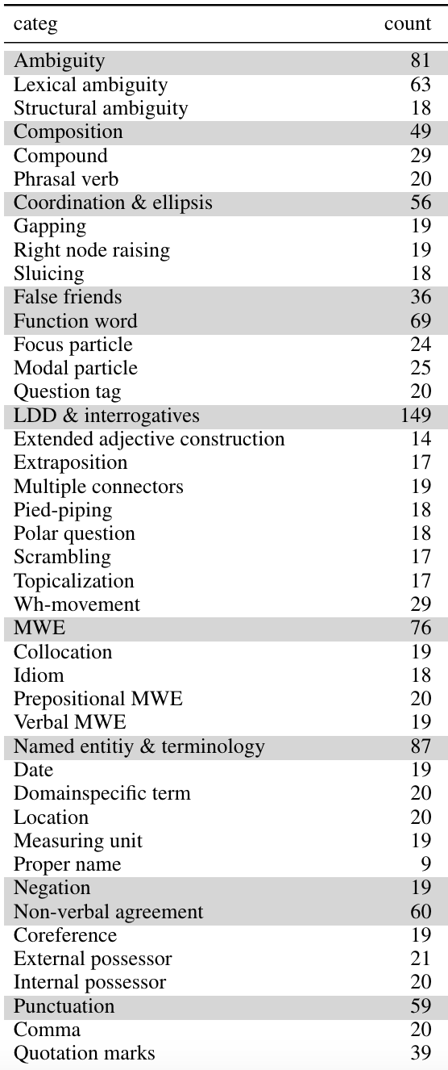
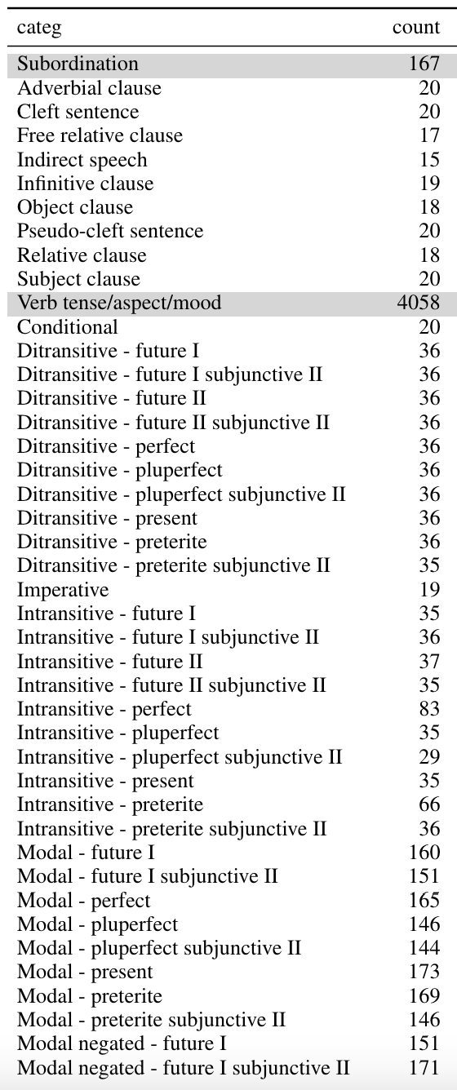
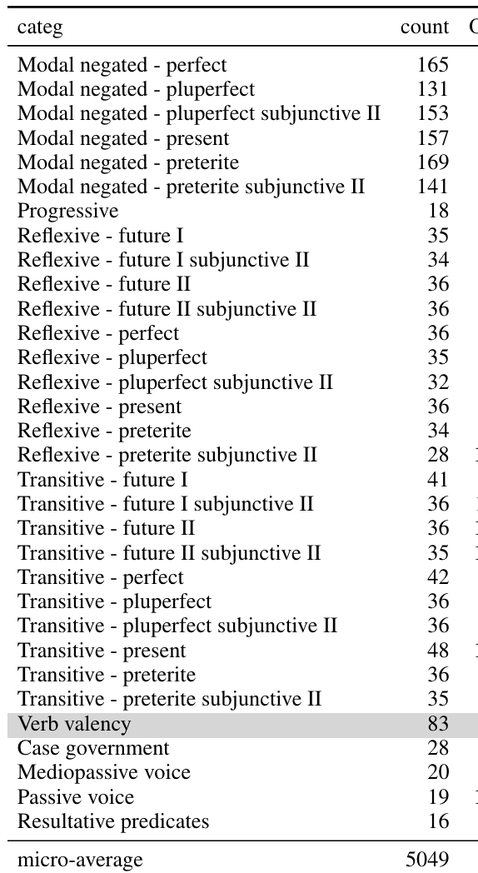
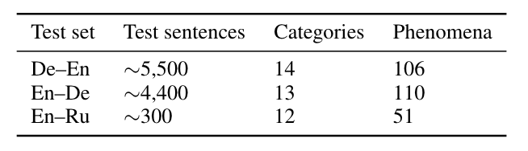
Linguistic Evaluation Benchmark: Category
For De-En,
14 categories,
106 phenomena,
and >5,000 sentences.
Notes:
A figure showing this

Slide 44
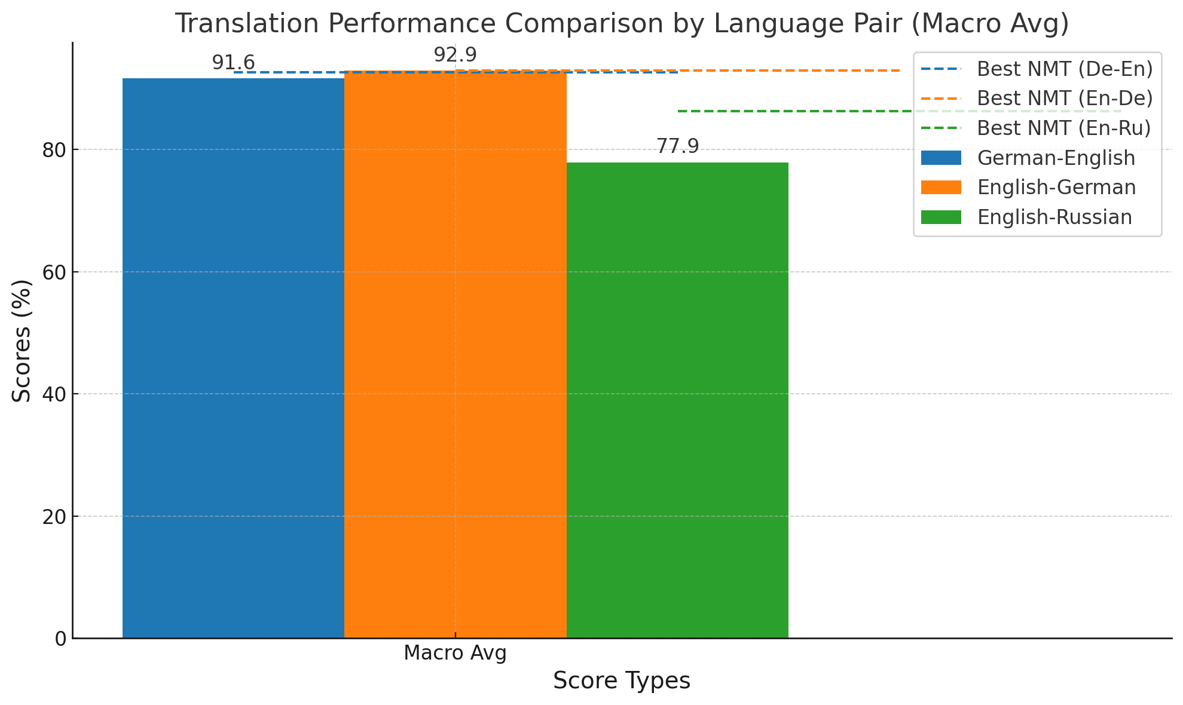
Linguistic Evaluation on the MT Output of GPT-4
Can GPT-4 outperforms traditional NMT models?
Comparable on high-resource directions
Not in lower-resource directions.
[4] Linguistically Motivated Evaluation of the 2023 State-of-the-art Machine Translation: Can GPT-4 Outperform NMT?
Notes:
https://lena-voita.github.io/posts/acl19_context.html

Slide 45

Linguistic Evaluation on Metrics
Which MT quality estimation Metrics is better?
Check if the metric favors the correct one [2]
80
BERTScore
90
Good metric!
90
😤
XXXMetric
80
High-performance metrics for En-De
BERTScore
COMET-22
[2] Linguistically Motivated Evaluation of Machine Translation Metrics based on a Challenge Set
Notes:
A figure showing this

Slide 46
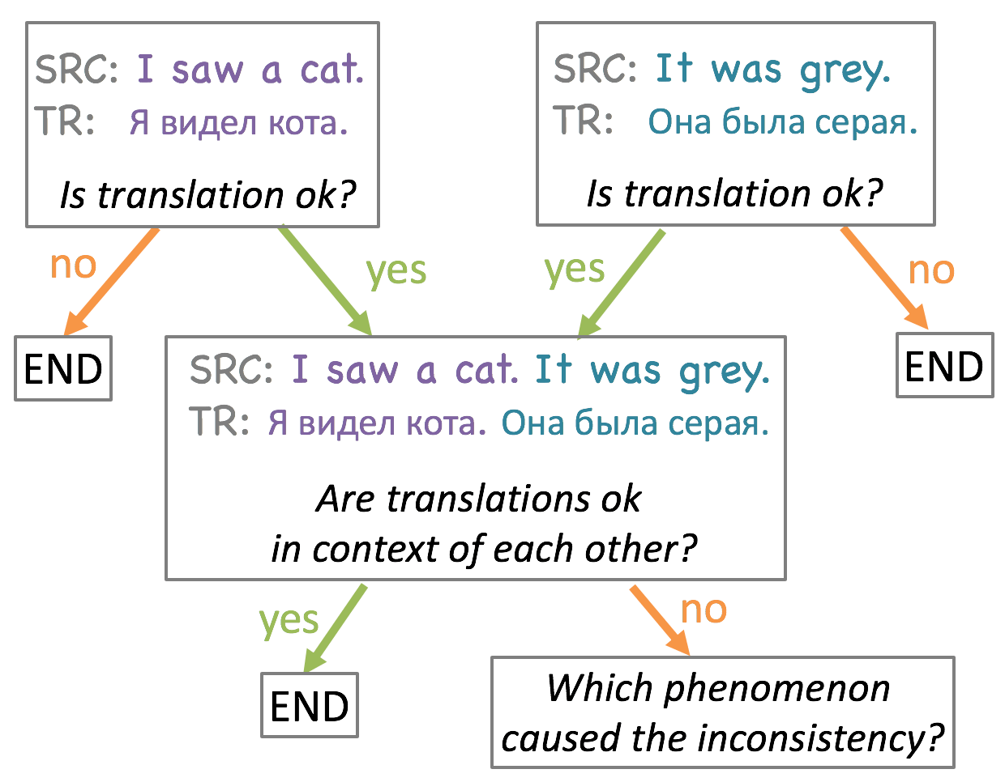
Linguistic Evaluation on Context-Aware MT
Translation should be contextual [3]
Possible that translation for a single sentence is correct but the combined translation is wrong.
Она and Он are indicative pronouns in Russian.
In the case of “cat”, Он should be used.
Reference: Он был серый.
[3] When a Good Translation is Wrong in Context: Context-Aware Machine Translation Improves on Deixis, Ellipsis, and Lexical Cohesion
Notes:
A figure showing this

Slide 47
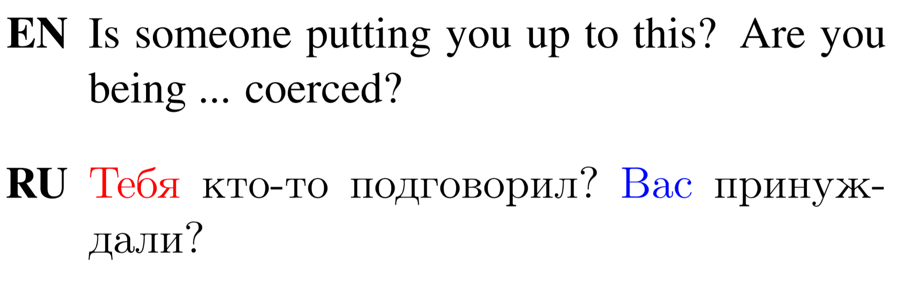
Phenomena in Context-Aware MT (1/3)
Deixis
Referential expressions whose denotation depends on context.
Violation of T-V form consistency
Informal form
Formal form
[3] When a Good Translation is Wrong in Context: Context-Aware Machine Translation Improves on Deixis, Ellipsis, and Lexical Cohesion
Notes:
https://lena-voita.github.io/posts/acl19_context.html

Slide 48
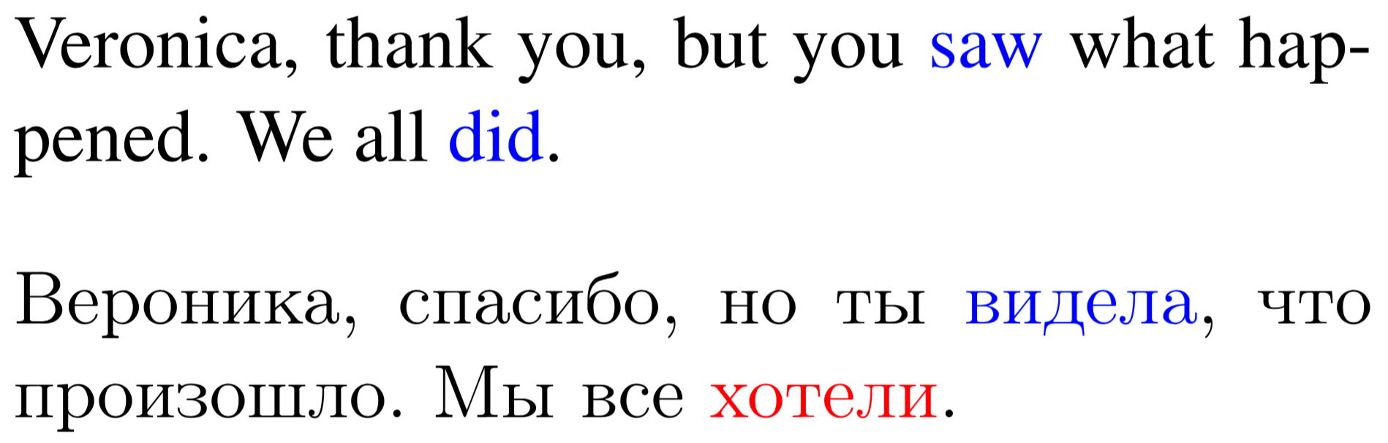
Phenomena in Context-Aware MT (2/3)
Ellipsis
The omission from a clause
“did” should be translated into a word meaning
“saw” (видела) but wrongly into “want” (хотели)
[3] When a Good Translation is Wrong in Context: Context-Aware Machine Translation Improves on Deixis, Ellipsis, and Lexical Cohesion
Notes:
https://lena-voita.github.io/posts/acl19_context.html

Slide 49
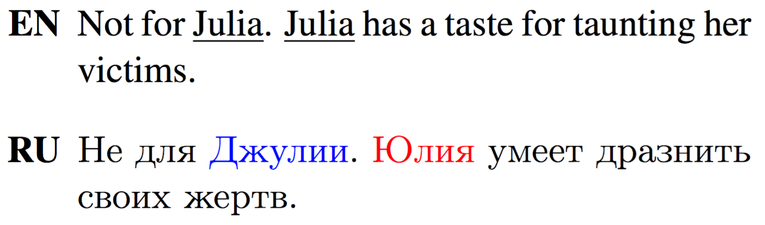
Phenomena in Context-Aware MT (3/3)
Lexical Cohesion
Named entity inconsistency
Translations of the name “Julia” are not consistent.
[3] When a Good Translation is Wrong in Context: Context-Aware Machine Translation Improves on Deixis, Ellipsis, and Lexical Cohesion
Notes:
https://lena-voita.github.io/posts/acl19_context.html

Slide 50
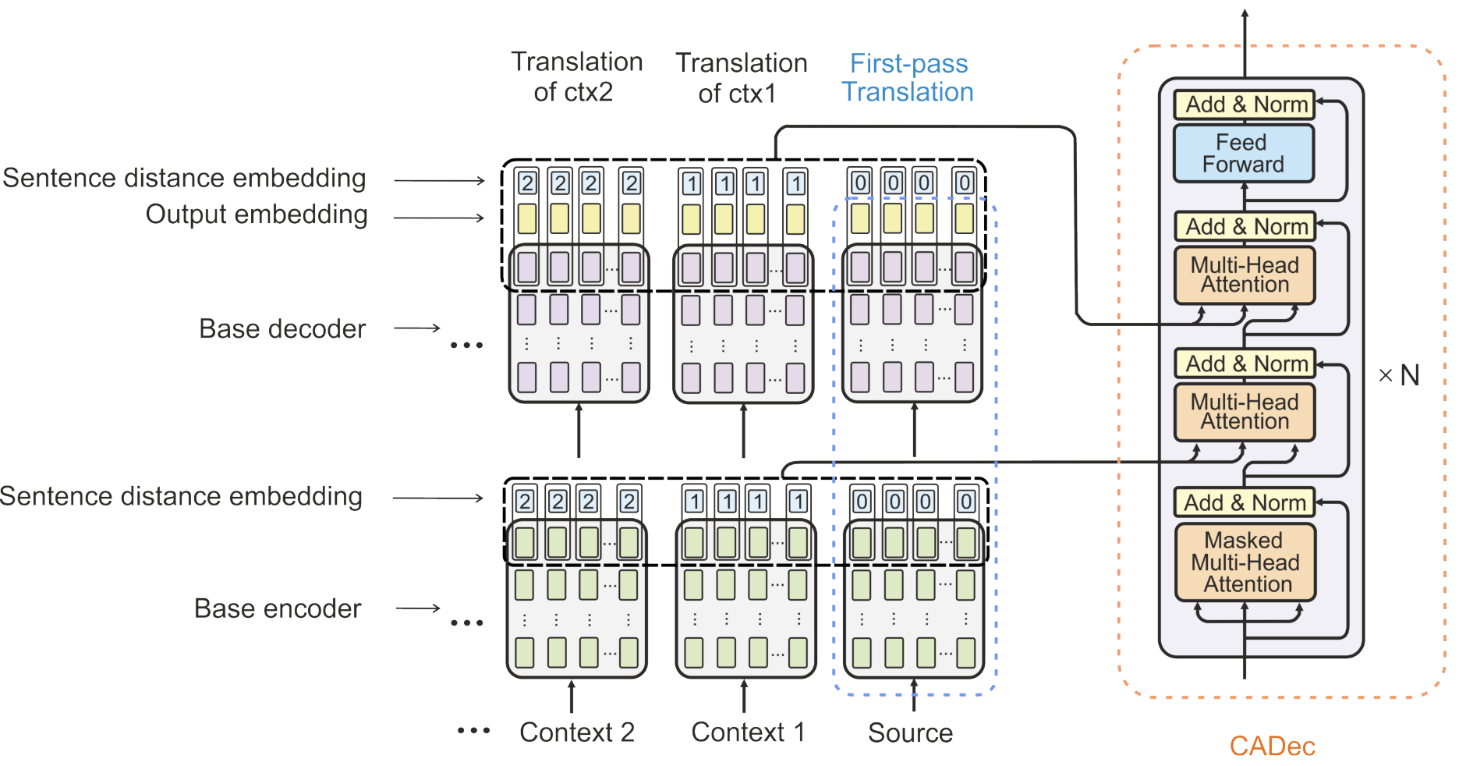
Context-Aware MT: Method
Feed context/first-pass translations with distance embeddings
Notes:
https://lena-voita.github.io/posts/acl19_context.html

Slide 51
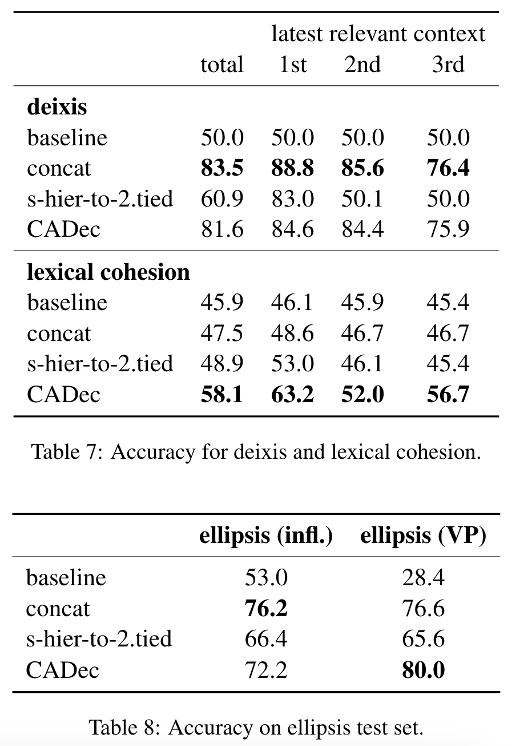
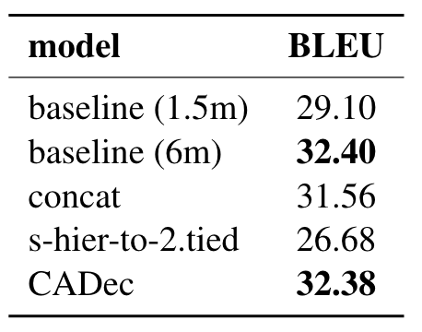
Context-Aware MT: Results
BLEU is comparable but linguistically evaluation results are good
Notes:
https://lena-voita.github.io/posts/acl19_context.html

Slide 52
Summary
The linguistic evaluation benchmark provides a more fine-grained evaluation of MT outputs.
However, it is still semi-automatic and requires human effort.
Better to add BERTScore/COMET during evaluation which are consistent with this benchmark.
Traditional MT systems are still better than GPT-4 especially in low-resource directions.

Slide 53
References
[1] Linguistically motivated Evaluation of the 2022 State-of-the-art Machine Translation Systems for three Language Directions
[2] Linguistically Motivated Evaluation of Machine Translation Metrics based on a Challenge Set
[3] When a Good Translation is Wrong in Context: Context-Aware Machine Translation Improves on Deixis, Ellipsis, and Lexical Cohesion
[4] Linguistically Motivated Evaluation of the 2023 State-of-the-art Machine Translation: Can GPT-4 Outperform NMT?

